Slide 1


Slide 2
Tenure Review Advisory Committee
Columbia employs a standing committee system to conduct a final University-wide evaluation whenever a school, including Barnard College but excepting the Faculty of Law and Teachers College, recommends a candidate for tenure.
The standing committee – the Tenure Review Advisory Committee (TRAC) – serves in an advisory capacity to the Provost who determines whether the candidate should be recommended to the President and Trustees for tenure.
TRAC consists of 13 members chosen by the Provost from among the tenured faculty of Columbia and Barnard College.
Members serve staggered terms, normally three years in duration and the Provost designates one member in their third year to serve as its Chair.
Typically, 4 of the 13 members are from CUIMC.

Slide 3
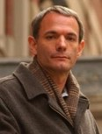
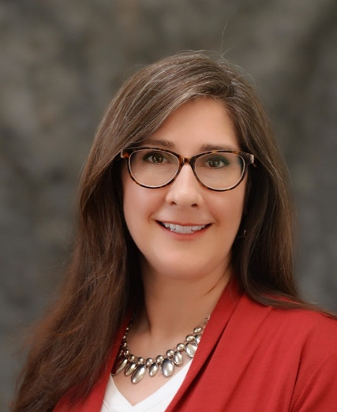
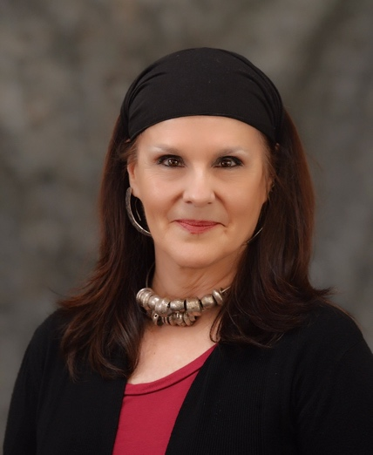
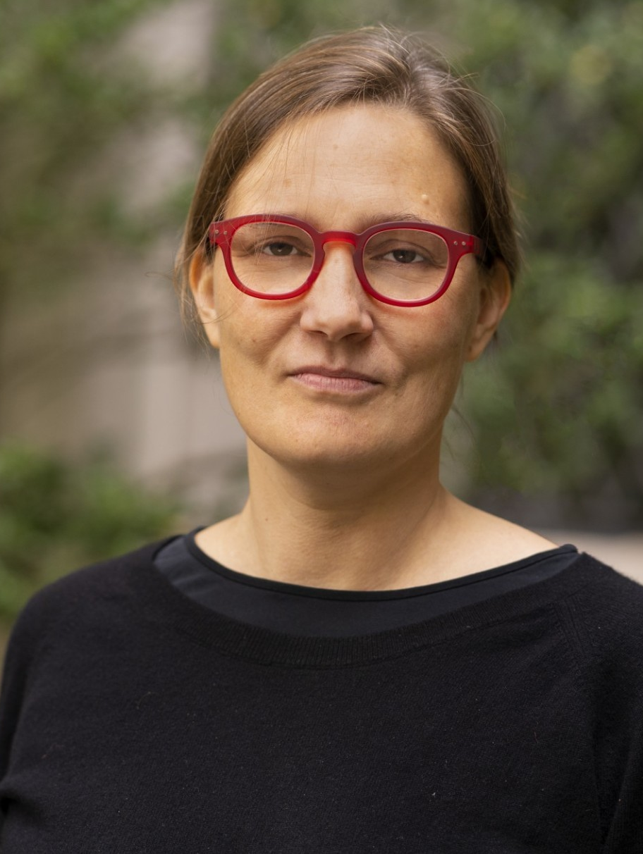
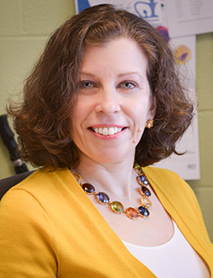


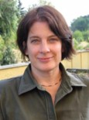
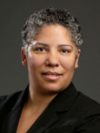
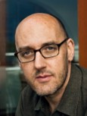

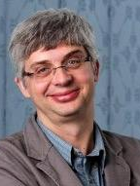
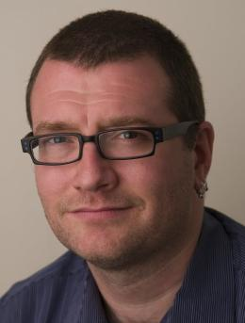
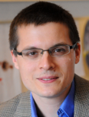
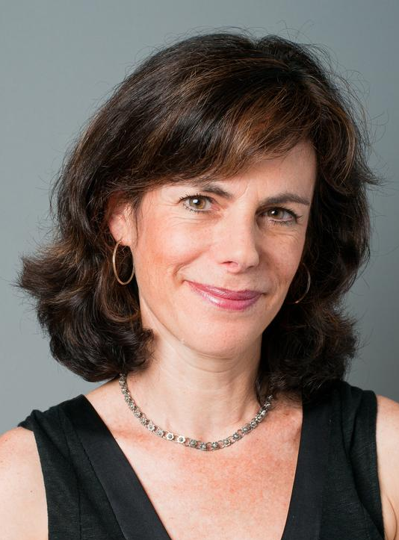
Current TRAC Members & Staff
Julien Teitler (Chair) Social Work
Angel Flesher
Assistant Provost
Linda Sheridan-Dasilva
Manager of Tenure Reviews
Courtney Bender
Religion
Donna Farber
Surgery, Microbio. & Immunology
Oliver Hobert
Biologic. Sci., Biochemistry
Gita Johar
Business
Laura Johnston
Genetics and Develop.
Jennifer Manly
Neurology
Ben Marcus
Writing
Steven Marx
Cardiology
Cristian Pop-Eleches
SIPA
Andrew Rundle
Epidemiology
Rocco Servedio
Computer Science
Lisa Tiersten
History, BC

Slide 4
Expectations for Tenure and Promotion
An appointment to tenure is made in the University only when an individual of widely recognized excellence is found to fill a scholarly need that is demonstrably vital to a discipline central to the University's purposes. The process of tenure review, therefore, is concerned with both the qualities of the nominee and the potential impact of the proposed appointment on the nominating department or school.
The nominee must be an outstanding scholar, a person who has demonstrated the capacity for imaginative, original work and who shows promise of continuing to make significant contributions to research and teaching.

Slide 5
University Policies and Procedures
All rules, policies and procedures reviewed in this document may be located on the following sites:
Columbia University Tenure Guidelines
Policies and Procedures on limits of non-tenured service
Columbia University Charters and Statutes
  VII – Code of Academic Freedom and Tenure
Faculty Handbook

Slide 6
Timeline for Dossier Submission
April 1, 2026 - List of faculty from each School who will be reviewed for tenure in 2026-27, along with the candidate’s CVs and field descriptions are due in the Office of the Vice Provost for Faculty Affairs (OVPFA).
May 15, 2026 - Confirmations that referees were solicited for each candidate by the Schools are due in the OVPFA. Non-negotiable.
December 15, 2026 - All internal candidate nominations are due in the OVPFA. Non-negotiable. If a department misses this date for nominating internal candidates, TRAC may defer its consideration of the nominee until it has finished the review of others who were nominated on time, even if that means postponing the evaluation to the following academic year.
February 1, 2027 - All external candidate nominations are due in the OVPFA. Non-negotiable.

Slide 7
Local Timeline
The process of starting the dossier starts 1.5 years ahead of a possible review at the Provost level.
In the 6th or 9th counted year of the candidate’s service, departments decide whether they will proceed reviewing a candidate and if they decide positively, will start collecting the materials for the dossier that year in order for departments to review the candidates in spring/summer and submit nominations by the 7th or 10th counted year.
The department submits the dossier to COAP in summer/fall of the 7th or 10th counted year for review to meet the University deadline of December 15th.
The Provostial level deadline of December 15th is non-negotiable. We are unable to receive nominations after that date.

Slide 8
Additional Points about Local Review
Every nomination requires a positive vote by the tenured faculty in the relevant department/division and/or school, and at COAP, along with the endorsement of the executive vice president, for it to proceed for university-wide review by TRAC.
OVPFA is in constant conversation with CUIMC Faculty Affairs about the status of dossiers starting at the level of the departmental review and all is transparent.

Slide 9
Tenure Dossier
Dossier Cover Sheet
Table of Contents
Curriculum Vitae
Reports
Case Statement
Statement of the Nominee
Supplemental Materials
Referee Evaluations
Preliminary Evaluations
Recommendation for Witnesses
All materials collected for any previous review for tenure

Slide 10
Tenure Dossier
Reports
A letter from the nominating Executive Vice President recommending the candidate for tenure and a letter or report from the school-level review committee recommending the candidate for tenure are included in all dossiers.
Case Statement
The case statement is compiled by the School and consists of the following sections:
  Analysis of the department/division and school
  Report on the nomination process
  Report on the vote
  Assessment of the nominee’s qualifications
    Research and scholarship
    Statistical summary of teaching evaluations
    The candidate’s qualifications in comparison with other scholars in the field should be discussed, including the candidate’s potential for future scholarly development

Slide 11
Tenure Dossier
Candidate’s Responsibility
A current curriculum vitae with its date of preparation.
Statement of the Nominee – A brief statement of no more than 5 –10 pages on their current and future plans with regard to research and teaching.
Publications and/or creative materials.
Any teaching evaluations from courses taught at Columbia or a previous institution.
For detailed information please refer to the University Tenure Guidelines.

Slide 12
Tenure Dossier: Candidate’s Responsibility
CURRICULUM VITAE
Every dossier requires a candidate’s current c.v. with its date of preparation and should include the following:
  Field of specialization
  Education
  All academic and non-academic positions held
  Honors, prizes and fellowships
  Grants and contracts
  Publications (in bibliographic form)
  Patents
  Teaching experience
  Invited talks
  Service

Slide 13
Tenure Dossier: Candidate’s Responsibility
Statement of the nominee
The nominee prepares a brief statement of no more than 5-10 pages their current and future plans with regard to research (or artistic or professional activities when relevant) and teaching. The purpose of the statement is to provide TRAC with information about projects that are underway but have not been completed and those that are still in the planning stage rather than about research that has already been completed. The candidate also uses the statement to discuss their teaching philosophy.
Supplemental Materials
The nominating department/division and school may include in the candidate's dossier any additional information it wishes TRAC to consider (for example, teaching evaluations, course syllabi, letters from students, articles and unpublished manuscripts, and reviews of works).

Slide 14
Tenure Dossier: Referee Section
Referee Evaluations
The section includes the following:
  List of top ten institutions in the candidate’s field
  Annotated list of referees
  Annotated list of comparison scholars
  Sample of letter sent to referees
  All responses from referees
  For internal candidates, the list of referees solicited and responses for the promotion to Associate Professor, if applicable, along with all letters received.

Slide 15
Referee Letters
The lists of referees and comparison scholars should be compiled by the EVP taking suggestions received from the department. The candidate should not be consulted in constructing these lists.
TRAC requires at least 10 letters from referees who are independent.
Referees who are not independent include:
  dissertation advisor
  postdoctoral mentor
  principal or co-investigator on a grant with the nominee
  coauthored work with the nominee or was formal collaborator
  current or former colleagues
  individuals who have served in an advisory capacity to the candidate including those who were on the candidate’s dissertation committee
  individuals who have funded the candidate through sponsored projects

Slide 16
Comparison Scholars
The comparison list should consist of at least five scholars whose qualifications would merit an appointment to tenure at Columbia.
They should be leading figures, even when the nominee is a junior scholar. The referees are asked to give their assessment of whether the nominee has the potential of reaching the level of achievement of the more senior comparison scholars.
The comparison list should not include nontenured scholars even when the candidate is a junior member of Columbia’s faculty.

Slide 17
TRAC Review Panels
Five TRAC members are assigned to the review panel for each tenure candidate.
One of the panel members is designated as a primary reviewer and has to review the dossier in depth and provide a detailed summary to the committee.
One of the panel members is a secondary reviewer who supplements the detailed review from the primary member.
The other panel members review the dossier in depth but do not provide detailed summaries.
Each panel member independently prepares a report on the candidate’s qualifications.
Panel members may be close in discipline to the candidate, but all panels include someone distant from the candidate’s field.

Slide 18
Tenure Decision
The Provost makes tenure decisions following the TRAC review taking into consideration all aspects of the case.
The Provost communicates the decision to the President, and the President forwards the recommended tenure nomination to the University Trustees for their approval.
In rare cases, TRAC requests additional information on a candidate. This is discussed in a second meeting. If following a second meeting, tenure is denied, the EVP is informed of this decision and they inform the candidate and the candidate is given a letter of nonrenewal.
The rate of success of tenure cases at the TRAC level is exceedingly high.

Slide 19
Questions?

